Slide 1
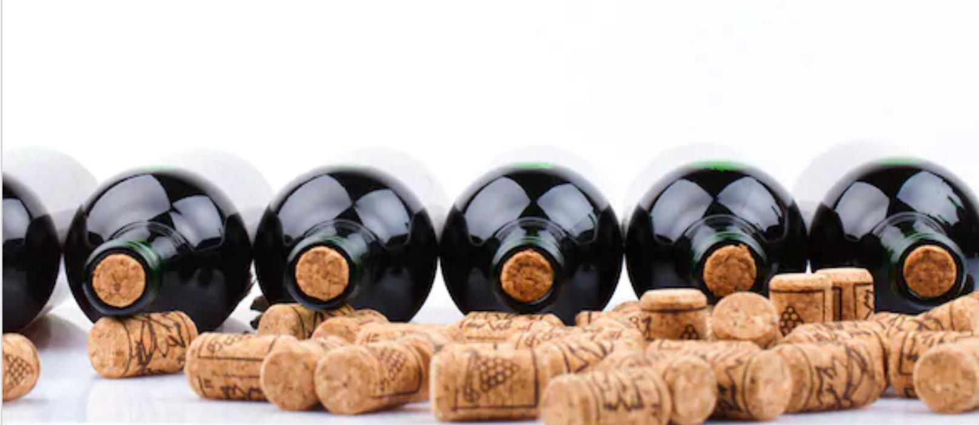
How Do You Determine A Quality Wine?
Professionals from all specialized industries use dense jargon and Sommeliers find themselves to be no exception. With the obscurity and gatekeeping often displayed by connoisseurs, our goal was to reveal a simple and clear-cut analysis on what makes some wines better than others so that you could easily decide on a variety and title.

Slide 2
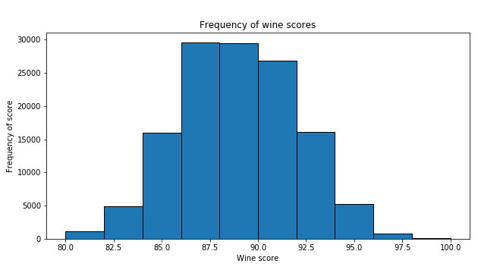
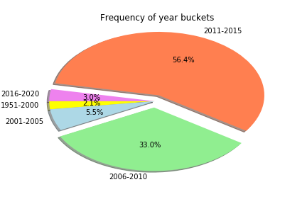
Data Sources
&
Data Limitations

Slide 3
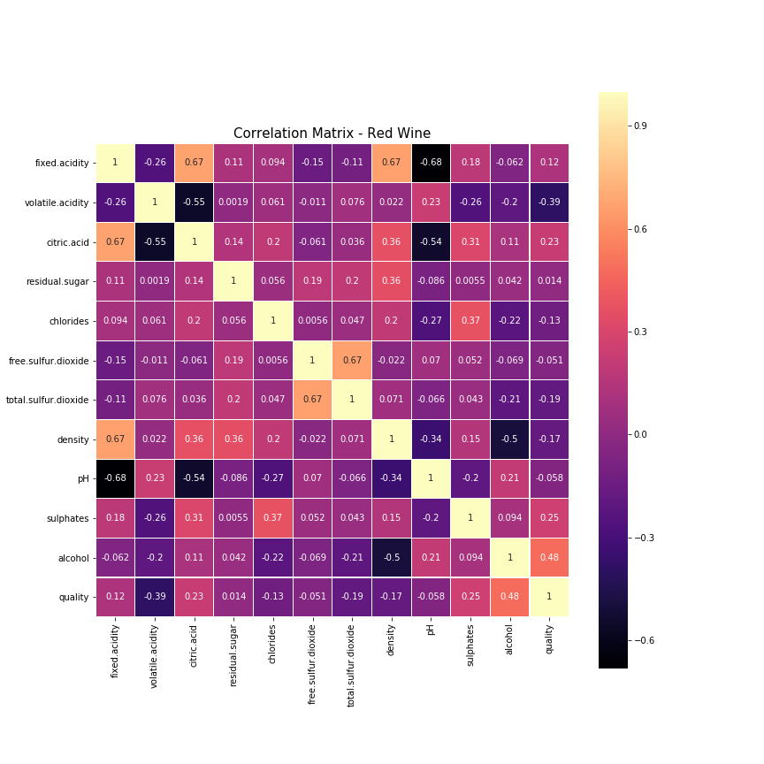
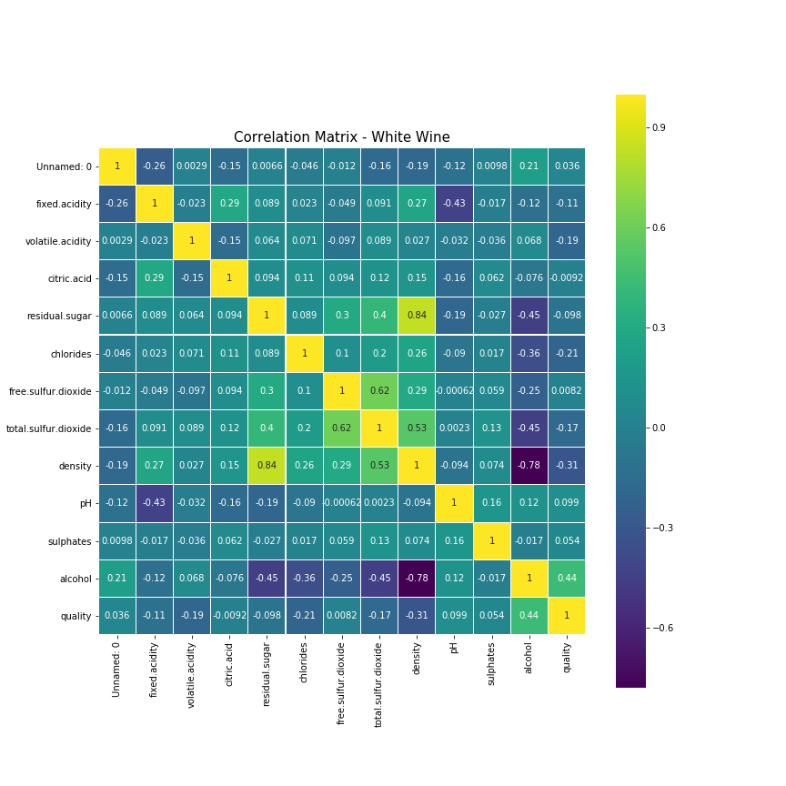
Composition
&
Quality

Slide 4
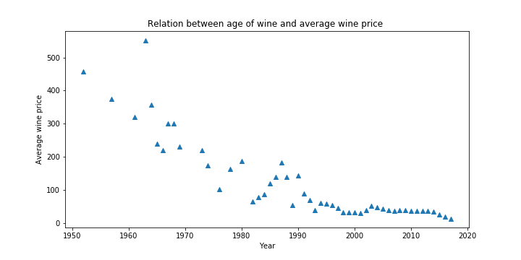
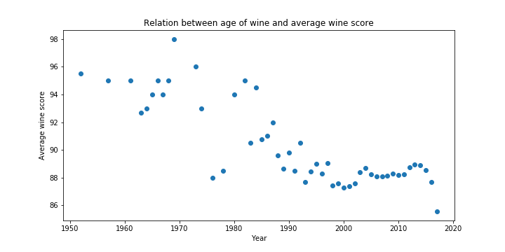
Age
&
Perceived Value

Slide 5
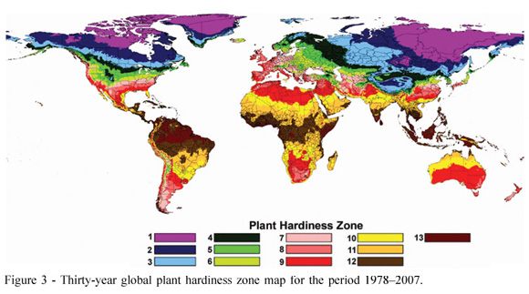
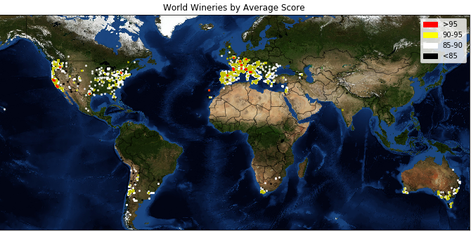
Value
&
Variety

Slide 6
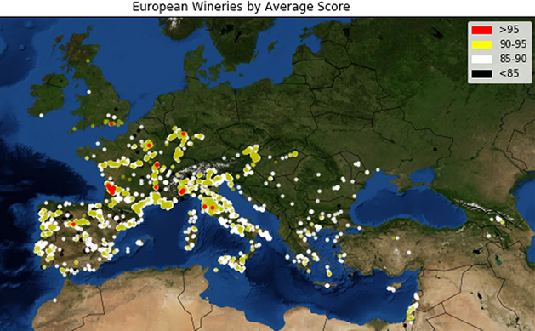
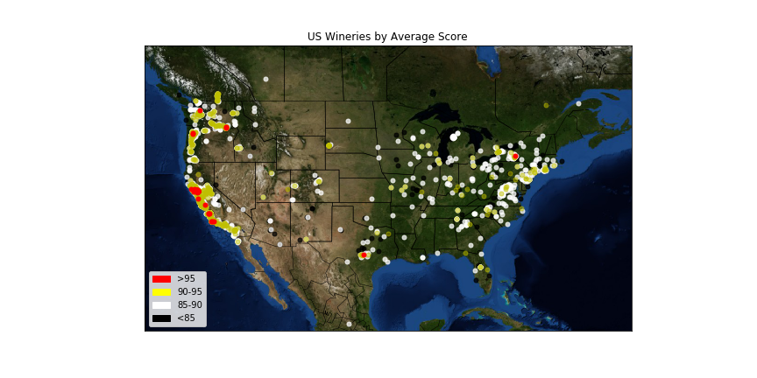
Value
&
Variety

Slide 7
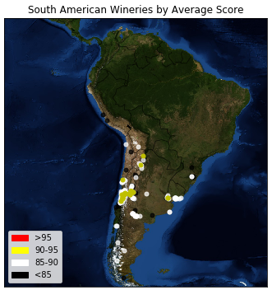
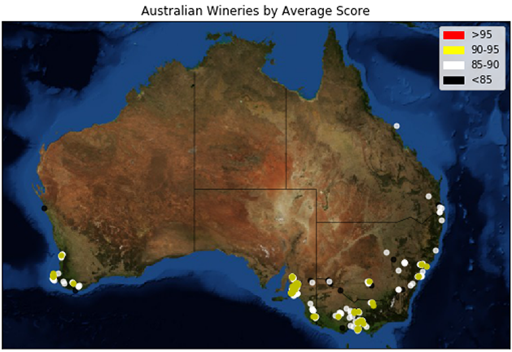
Value
&
Variety

Slide 8
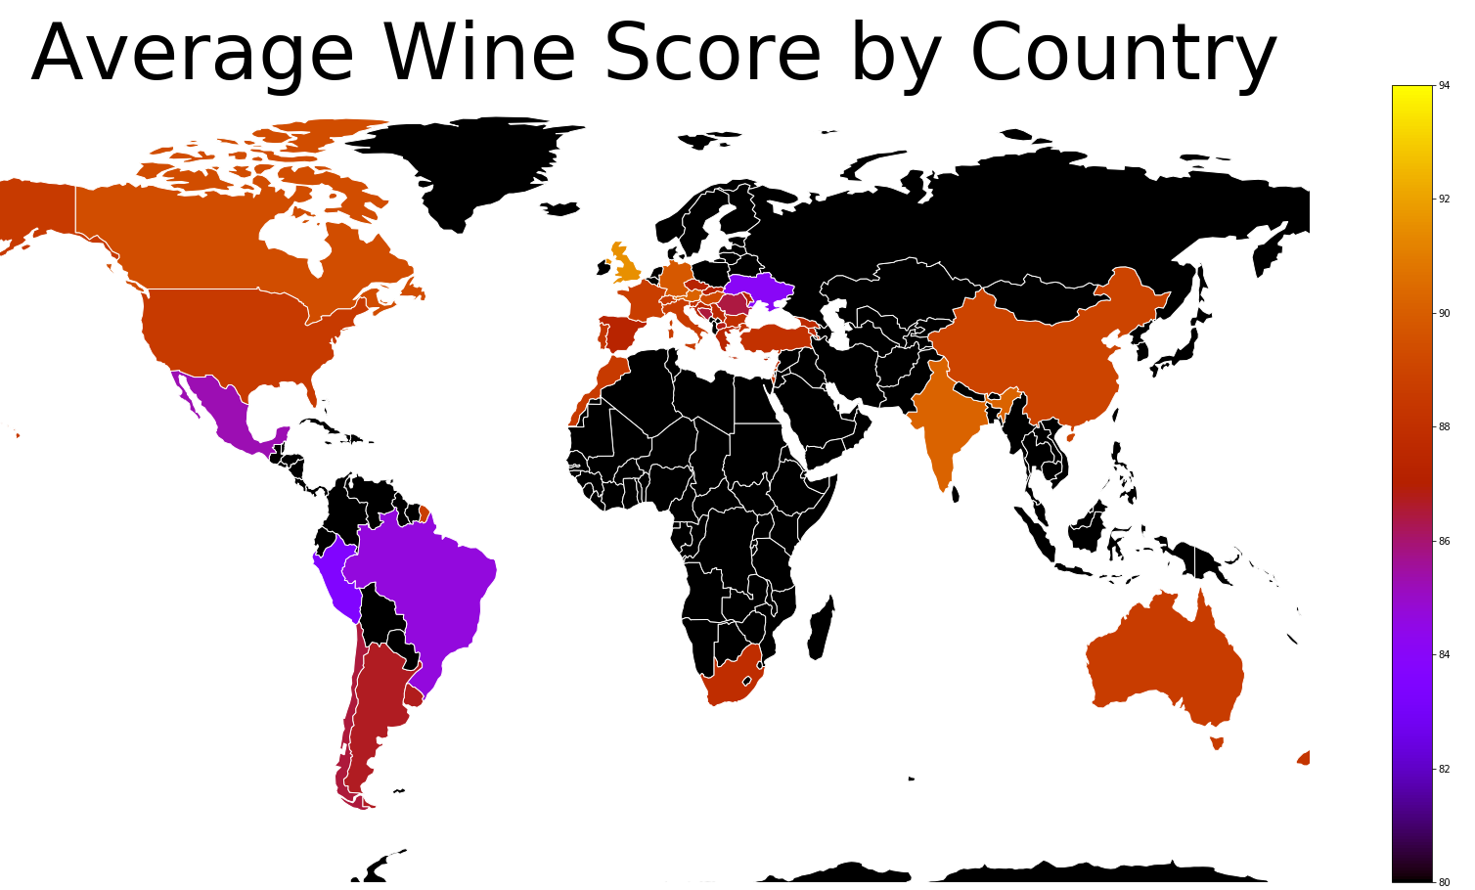
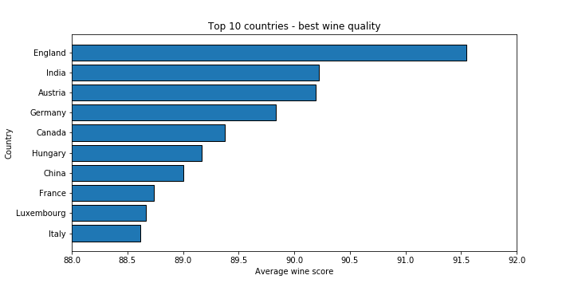
Quality
&
Price Correlation

Slide 9
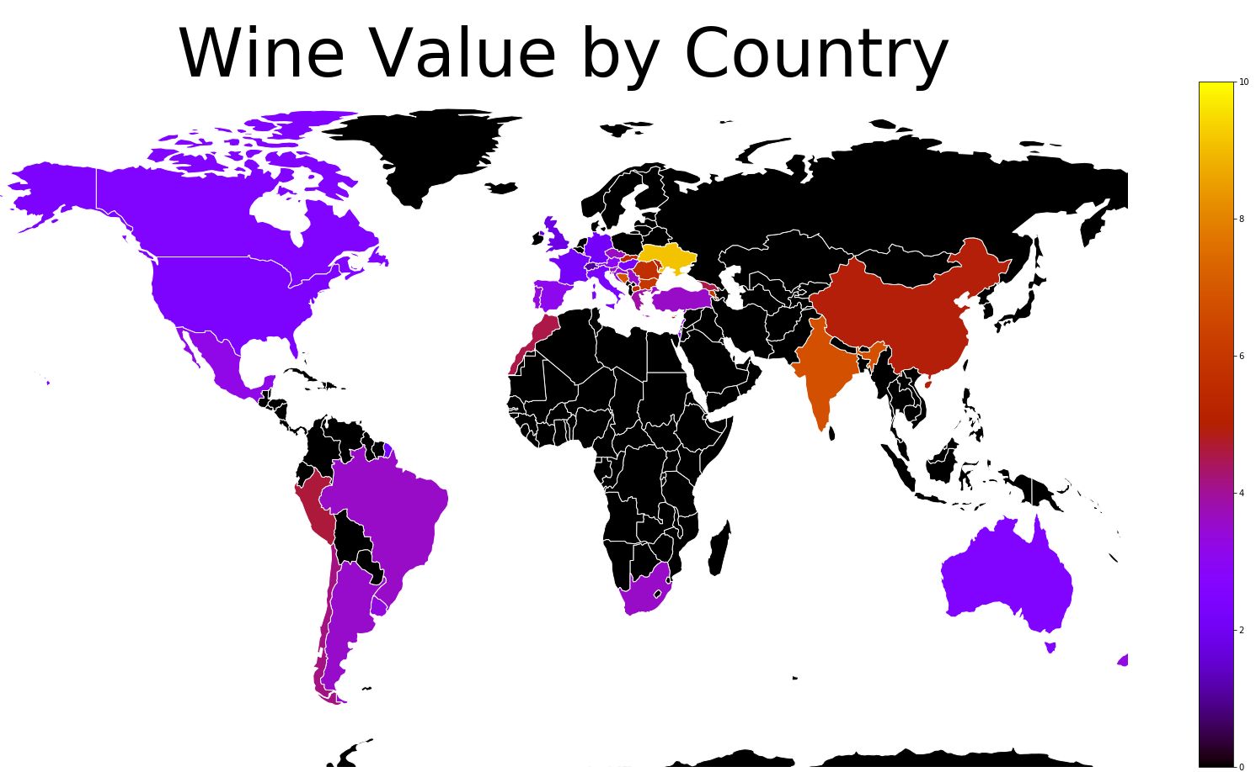
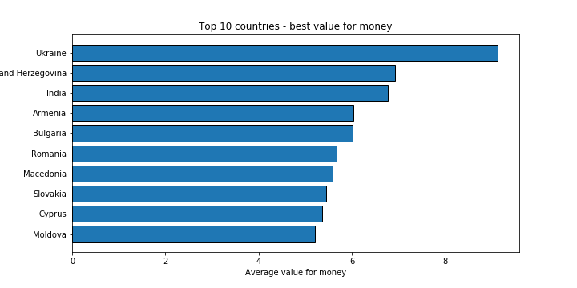
Value
&
Variety

Slide 10
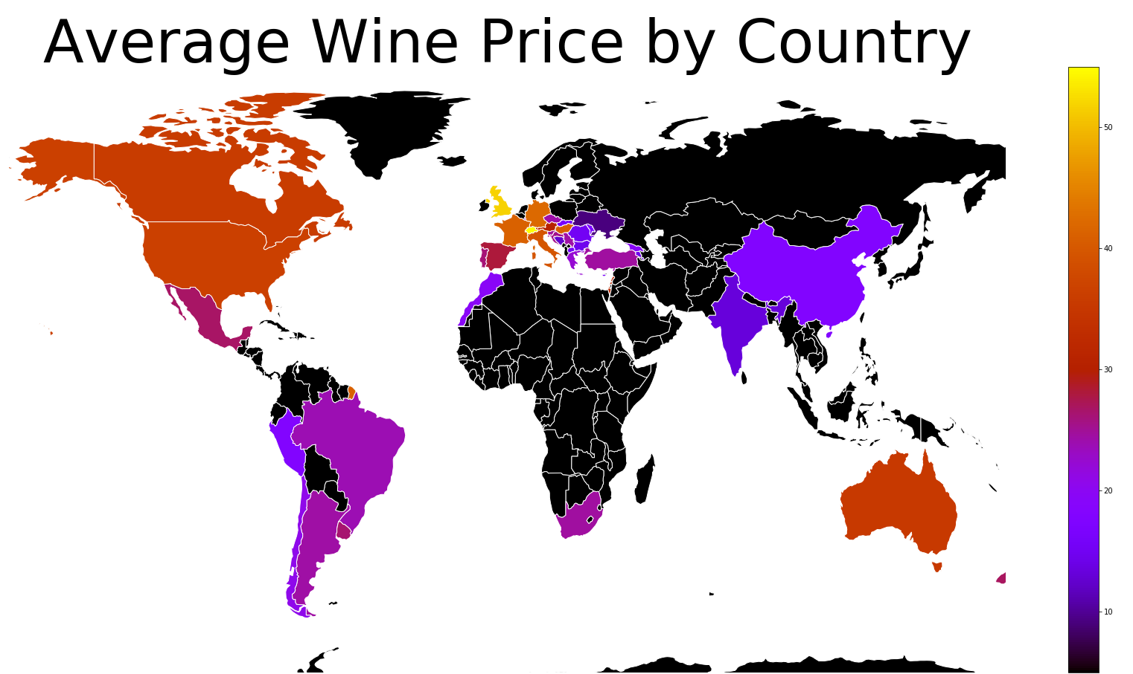
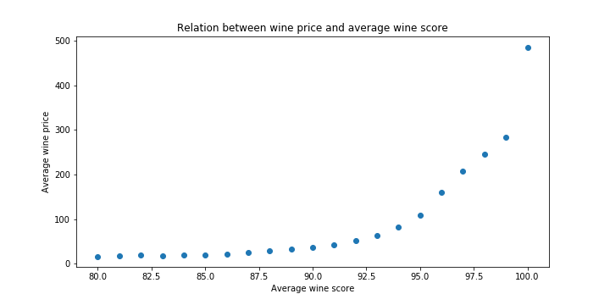
Quality
&
Price Correlation

Slide 11
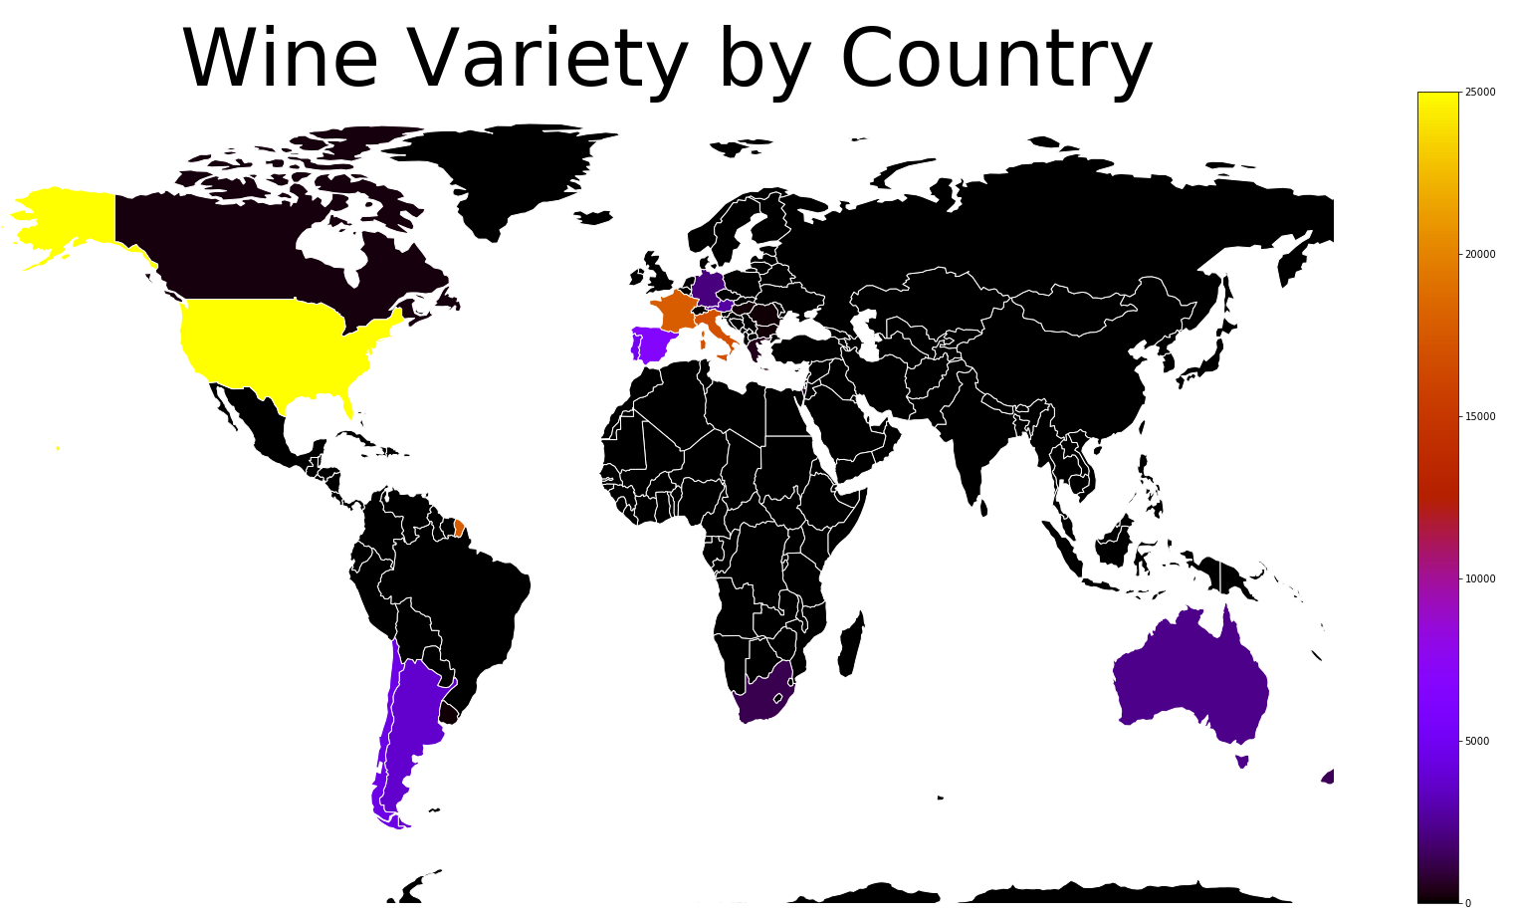
Variety
&
Country

Slide 12
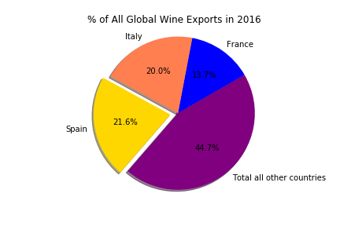
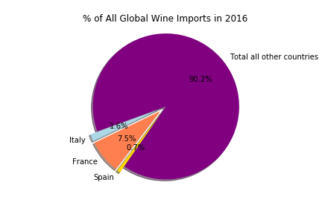
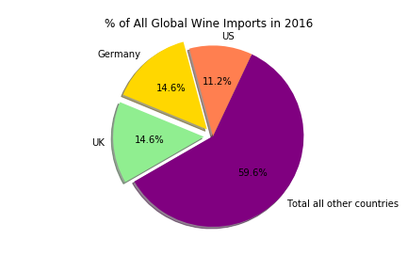
Imports
&
exports
2016 Global Trade in Wine

Slide 13
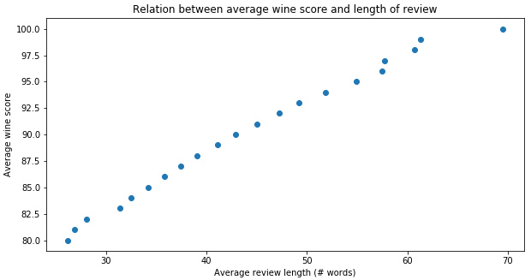
Verbosity
&
Wine Score

Slide 14
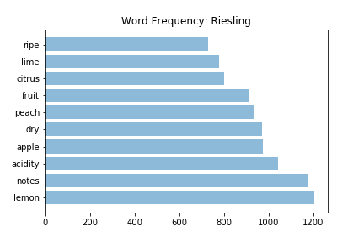
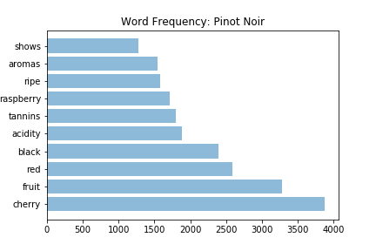
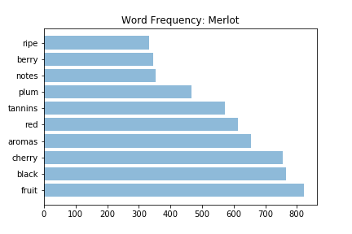
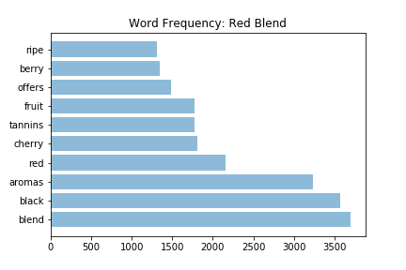
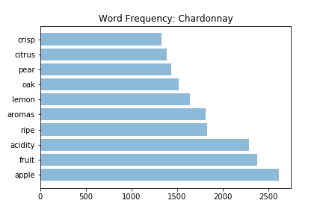
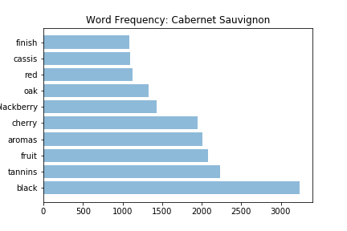
Palate
&
Preferences

Slide 15
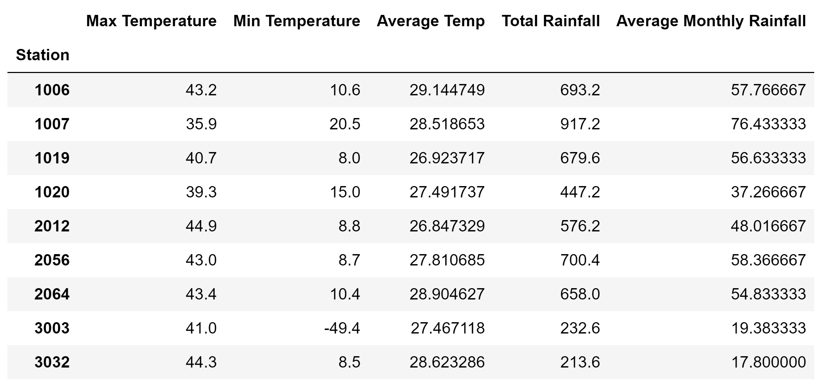
Weather
&
Quality Down Under

Slide 16
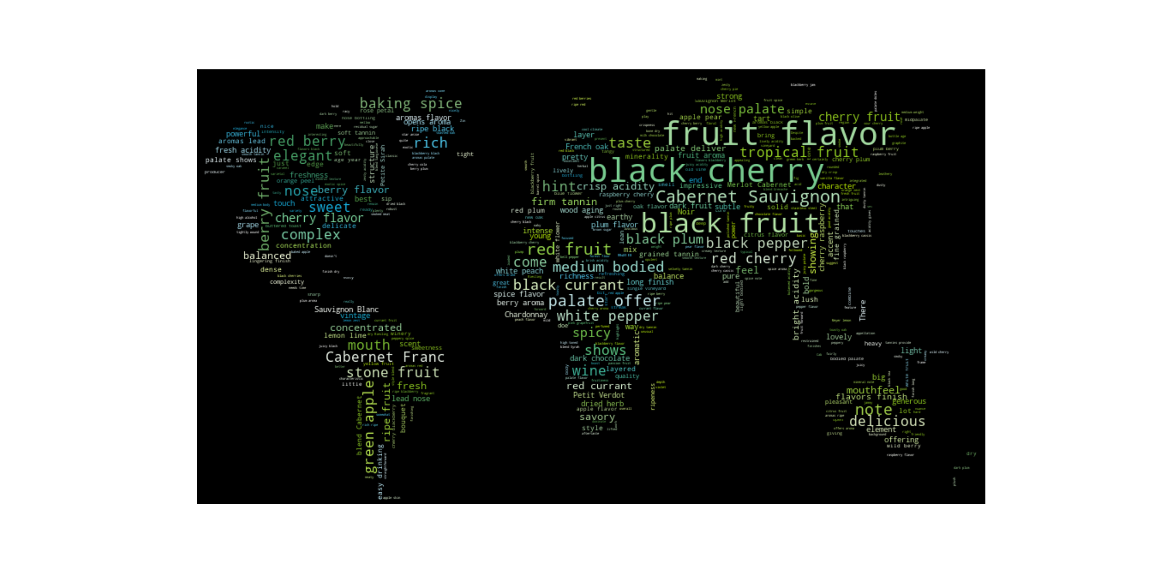
Words
&
Wines

Slide 17





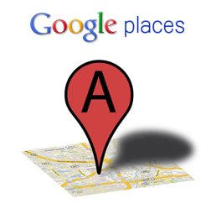


Data Sources
&
Data Cleaning Methods
CSVs
APIs
Multi-sheet excel

Slide 18
P. Cortez, A. Cerdeira, F. Almeida, T. Matos and J. Reis. Modeling wine preferences by data mining from physicochemical properties. In Decision Support Systems, Elsevier, 47(4):547-553. ISSN: 0167-9236.

